Slide 1
2004 OPC paper
Schilling et al.

Slide 2
Aims/Questions
Characterise patterns of zooplankton across a major upwelling region
Describe observed cross-shelf patterns
In oceanography (upwelling etc)
Does this reflect productivity/zooplankton
Do stats, see if any potential drivers of zooplankton variables (?)
Propose testable hypotheses for the future
Not sure statistical models are the best way forward. The data is pretty confounded….

Slide 3
Summary
Inner shelf water and EAC comparison
~30km transects
3 cross shelf CTD transects (no Cape Byron)
Nutrients in this I think (but can’t find raw MNF Data)
4 cross shelf transects with modified seasoar
OPC + CTD
ADCP
DH + NS at night, EH + CB in day (This is probably important? – diel vertical migration)

Slide 4
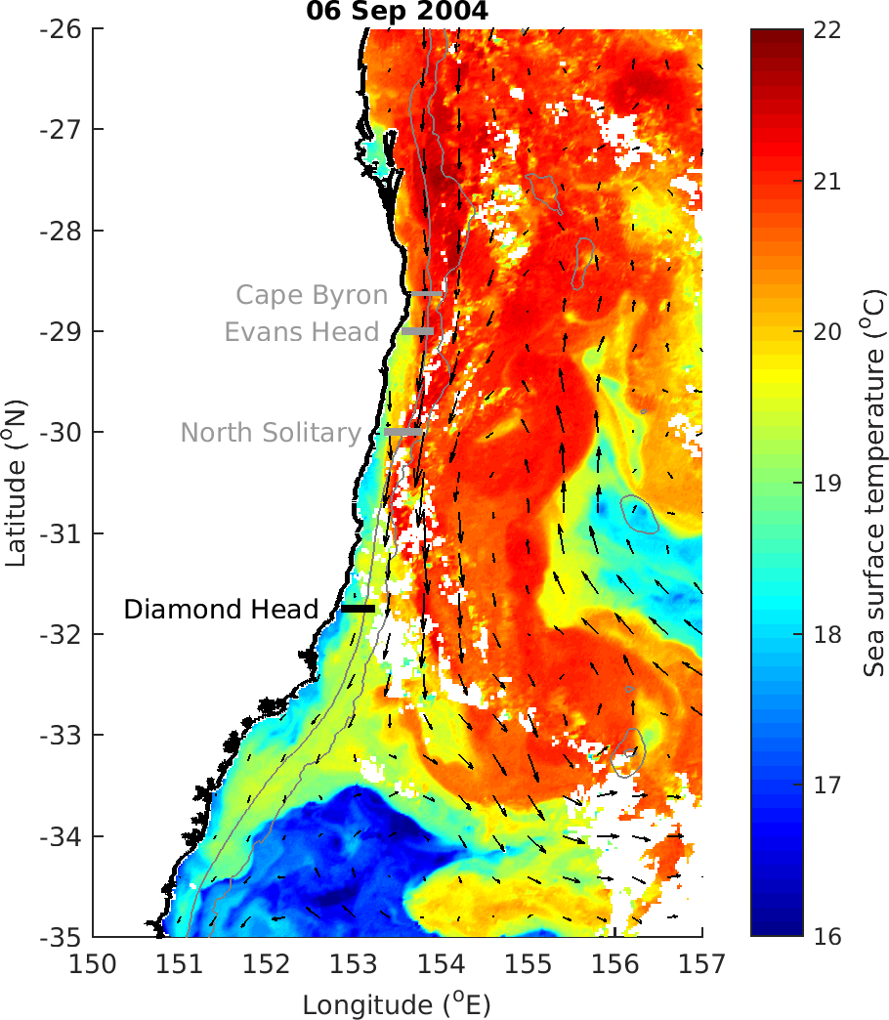
Figure 1 (or similar)
Site map with some oceanography
I like the SST ones

Slide 5
Oceanography
Southerly flow at all sites, higher off shelf at all except Diamond Head
EAC large influence at most sites, not so much at Diamond Head
Diamond Head has largest inshore zooplankton biomass.
Large warm core eddy offshore at ~33°S
Upwelling: most at Diamond head? But low all over (based on nutrients and temperature)

Slide 6
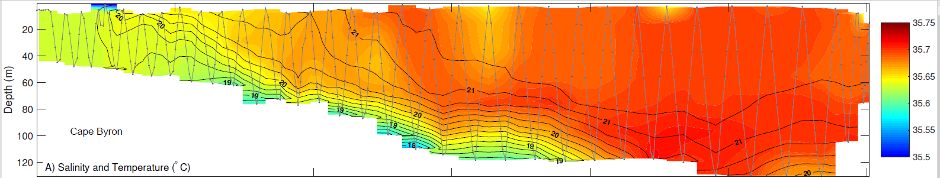
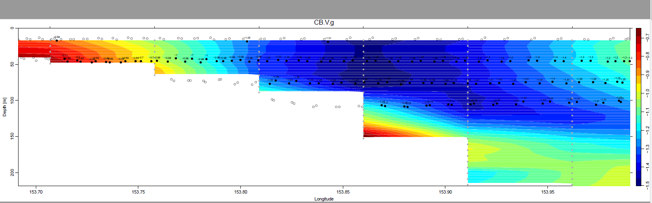
Figure 2
Temperature/Salinity Cross-section plots beside V velocity plots (highlight areas of EAC influence)
Eg: Cape Byron

Slide 7
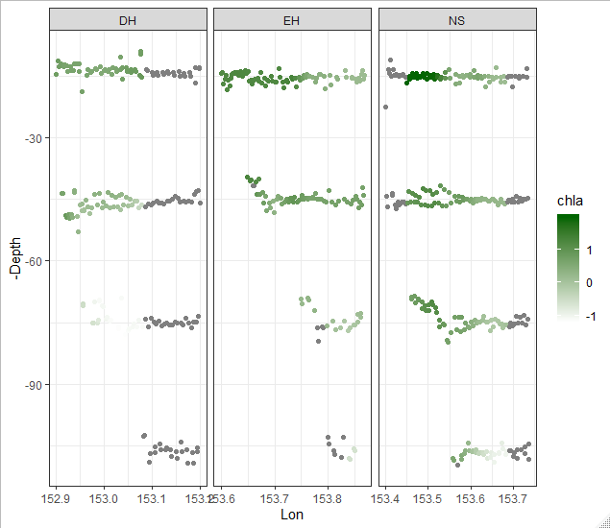
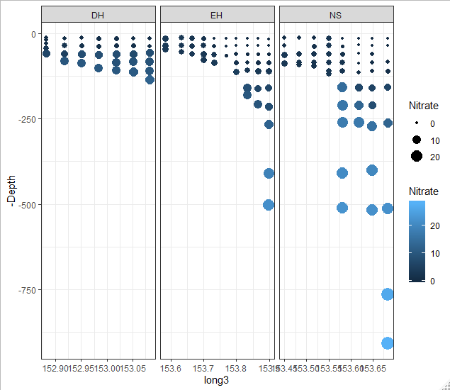
Figure 3
Cross sections of Chl_a and Nitrate (need to do better plots)
Should highlight upwelling
Phosphate & nitrate r = 0.99 (P < 0.0001)

Slide 8
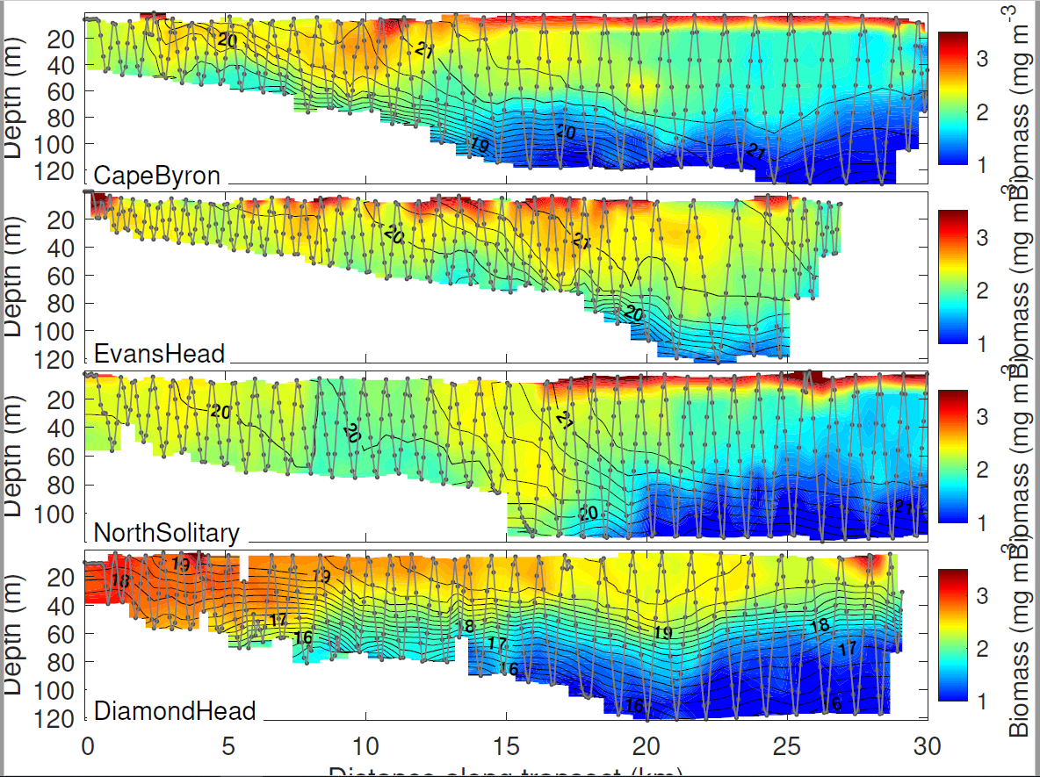
Figure 4
Zooplankton cross-shelf plots
Biomass
Slope
Size?

Slide 9
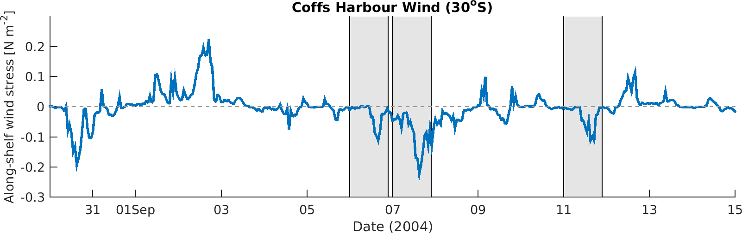
Upwelling Index
All dates show probably weak upwelling (unsure of magnitude)

Slide 10
Do a statistical model
Are the zooplankton metrics related to anything in particular?
Using the data Pete cleaned up – GLM
Latest thoughts: I don’t think this modelling is such a good idea, not really that much data and maybe confounded.

Slide 11
How to conclude
Can I come up with some testable hypotheses for future studies based upon the observations in this study?

